Slide 1

Spark Streaming ML Application
Sachin Kumar

Slide 2
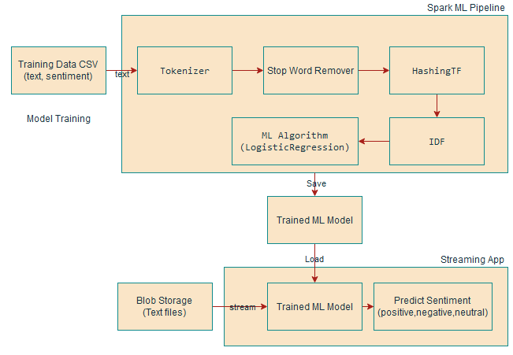
Sentiment Analysis On Incoming Data Stream

Slide 3
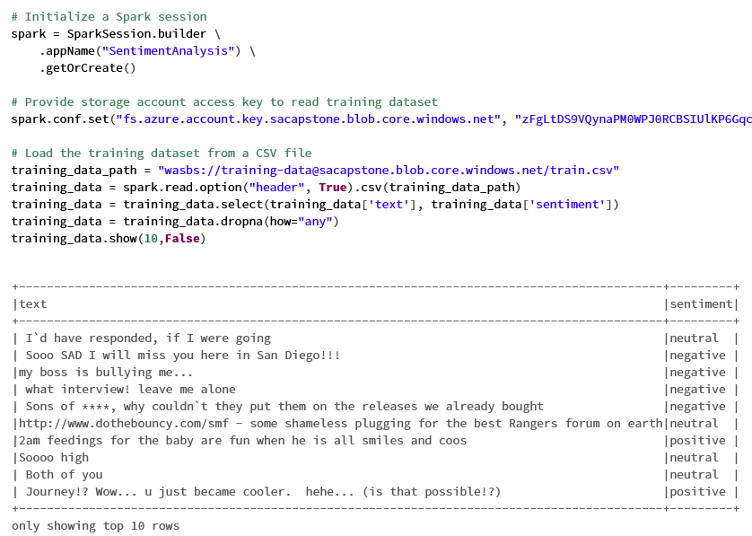
Reading Training Dataset

Slide 4
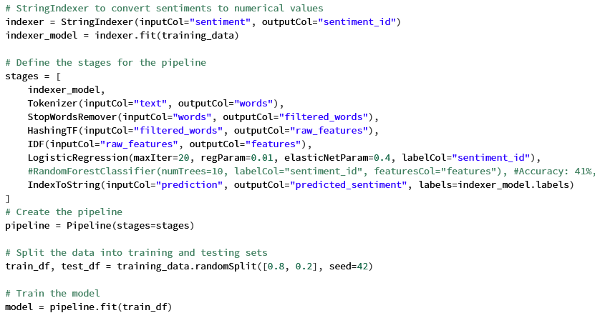
Training Model

Slide 5
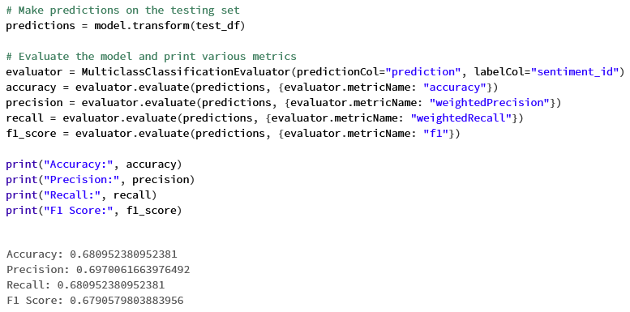
Model Evaluation

Slide 6
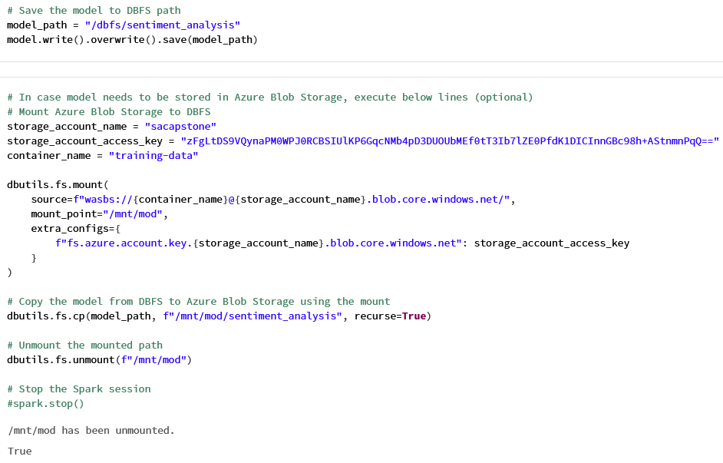
Saving Trained Model

Slide 7
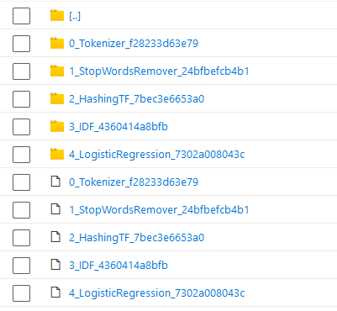
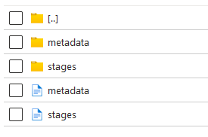
Saved Model Snapshot

Slide 8
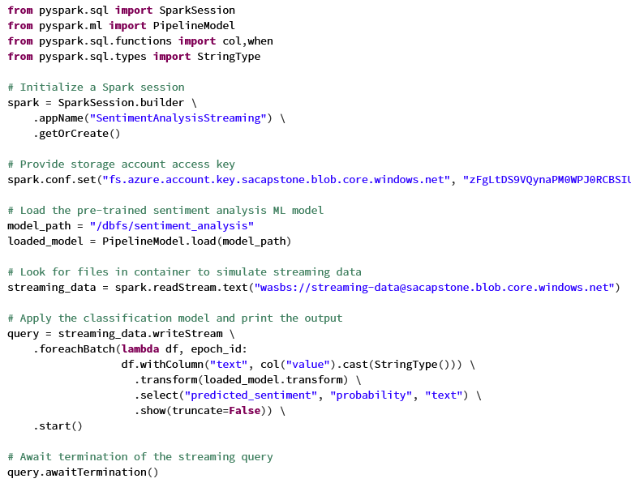
Streaming Application

Slide 9
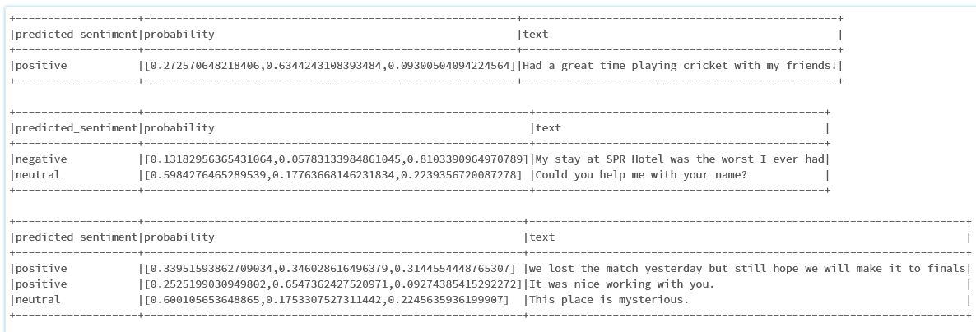
Sentiment Analysis

Slide 10
References
Training Dataset: https://www.kaggle.com/datasets/abhi8923shriv/sentiment-analysis-dataset

Slide 11
Thank You!

